Slide 1
Introduction to Java Programming with Blue J
Here is where your presentation begins

Slide 2
Table of contents
01
02
03
04
Introduction
Features of Java
Introduction to java and its
Founder.
All the basic features
of Java and java complier and interpeter and java libraries
Types of Java Programming
Java programming with Blue J
All the types of java programming and structure of java programming
Features of blue j , Sample program.

Slide 3
01.
Introduction
A brief introduction about java and its founder.

Slide 4
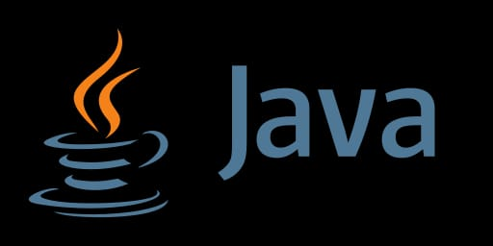
Introduction
JAVA was developed by James Gosling at Sun Microsystems Inc in the May 1995 and later acquired by Oracle Corporation. It is a simple programming language. Java makes writing, compiling, and debugging programming easy. Java’s history is very interesting. It is a programming language created in 1991. James Gosling, Mike Sheridan, and Patrick Naughton, a team of Sun engineers known as the Green team initiated the Java language in 1991. Sun Microsystems released its first public implementation in 1996 as Java 1.0.
Java is a class-based, object-oriented programming language that is designed to have as few implementation dependencies as possible. It is intended to let application developers write once, and run anywhere (WORA), meaning that compiled Java code can run on all platforms that support Java without the need for recompilation. Java was first released in 1995 and is widely used for developing applications for desktop, web, and mobile devices. Java is known for its simplicity, robustness, and security features, making it a popular choice for enterprise-level applications.

Slide 5
02.
Features of java
All the basic features of Java and java complier and interpreter and java libraries

Slide 6
Basics features of Java:-
Java is a popular programming language known for its versatility and robustness. Here are some of its basic features:
Object-Oriented: Java is based on the object-oriented programming paradigm, which helps organize complex programs into manageable pieces.
Platform-Independent: Java programs are compiled into bytecode, which can be run on any device equipped with a Java Virtual Machine (JVM), making them highly portable.
Simple and Easy to Learn: Java's syntax is similar to C++, but with fewer low-level facilities, making it easier to read and write.
Secure: Java has several built-in security features, such as bytecode verification and a security manager that defines access controls for classes.
Robust: Java emphasizes early error checking, runtime checking, and garbage collection to manage memory, making programs less prone to crashes.

Slide 7
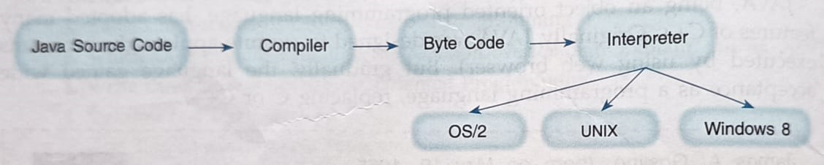
Java Interpeter and Complier.
Java Complier
Java Interpeter
The Java compiler (javac) takes the source code written in Java (with a .java extension) and compiles it into bytecode. The bytecode is an intermediate representation of the program, stored in .class files. Bytecode is platform-independent, which means it can be executed on any platform that has a Java Virtual Machine (JVM).
The JVM reads and executes the bytecode. The JVM interprets the bytecode for the specific platform it is running on. This interpretation involves translating the bytecode into machine code instructions that the host system's CPU can execute .

Slide 8
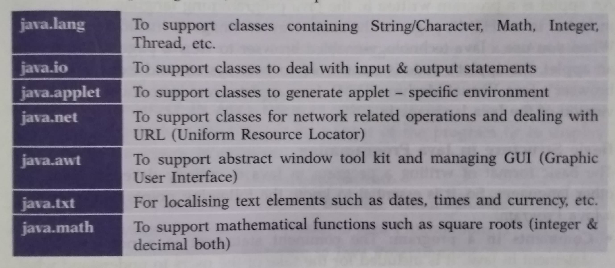
Java Libraries In JDK 1.3
Java libraries are collections of prewritten code that developers can use to perform common tasks, reducing the need to write code from scratch. These libraries provide reusable functions and classes that simplify the development of various applications. Below is an overview of some key Java libraries:-

Slide 9
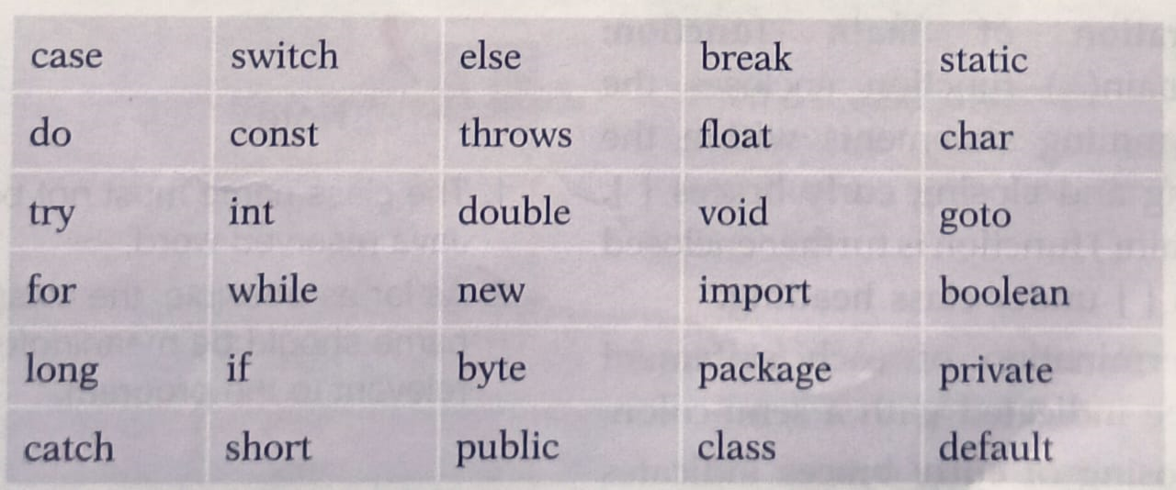
Java Reserved Words
Java reserved words, also known as keywords, are predefined identifiers that have special meanings in the context of the Java programming language. These words cannot be used as identifiers (such as variable names, class names, or method names) because they are reserved for specific purposes within the language syntax.

Slide 10
03.
Types of Java Programming
All the types of java programming and structure of java programming

Slide 11
Types of Java programming
In Java, there are primarily two types of programs you can develop:
Java applets and Java applications.
Here's a brief overview of each type :
Java Applet
1) Definition :A Java applet is a small application designed to be embedded within a web page and run in a web browser. It was popular in the early days of the internet for creating interactive content on web pages
2) Execution : Java applets require a web browser that supports the Java plugin to run. They are embedded in HTML pages using the <applet>` tag or <object> tag (in older implementations).
Java Application
1) Definition :A Java application is a standalone program that runs on the client machine (desktop or server) independently of a web browser.
2) Execution:• Java applications are executed directly by the Java Virtual Machine (JVM) installed on the user's machine. They are typically launched using the java mand from the command line or through a graphical interface.

Slide 12
Structure of Java Programming
Basic Structure in Java Programming
The basic format of writing a program in Java is entirely different from the other languages. So, it is essential to know the following points while writing a Java Program:
Comments in a program: The comment statement is a non executable statement in Java. It is included for the sake of the users to understand what action is going to be taken in a program or statement.
Declaration of class: It contains the word, access specifier (i.e., public). It also defines the keyword 'class' which is followed by a meaningful class name. For example, if you are writing a program to find the sum of two numbers, then it could be written as public class Sum. Conventionally, the class name starts with an uppercase letters.
Declaration of main function: The main() function encloses the programming statements within the opening and closing curly braces ( ) The main() function is further enclosed within | under class heading.
The termination of each statement must be indicated with a semi-colon . The closing of curly braces indicates the closing of a block of statements, function and class

Slide 13
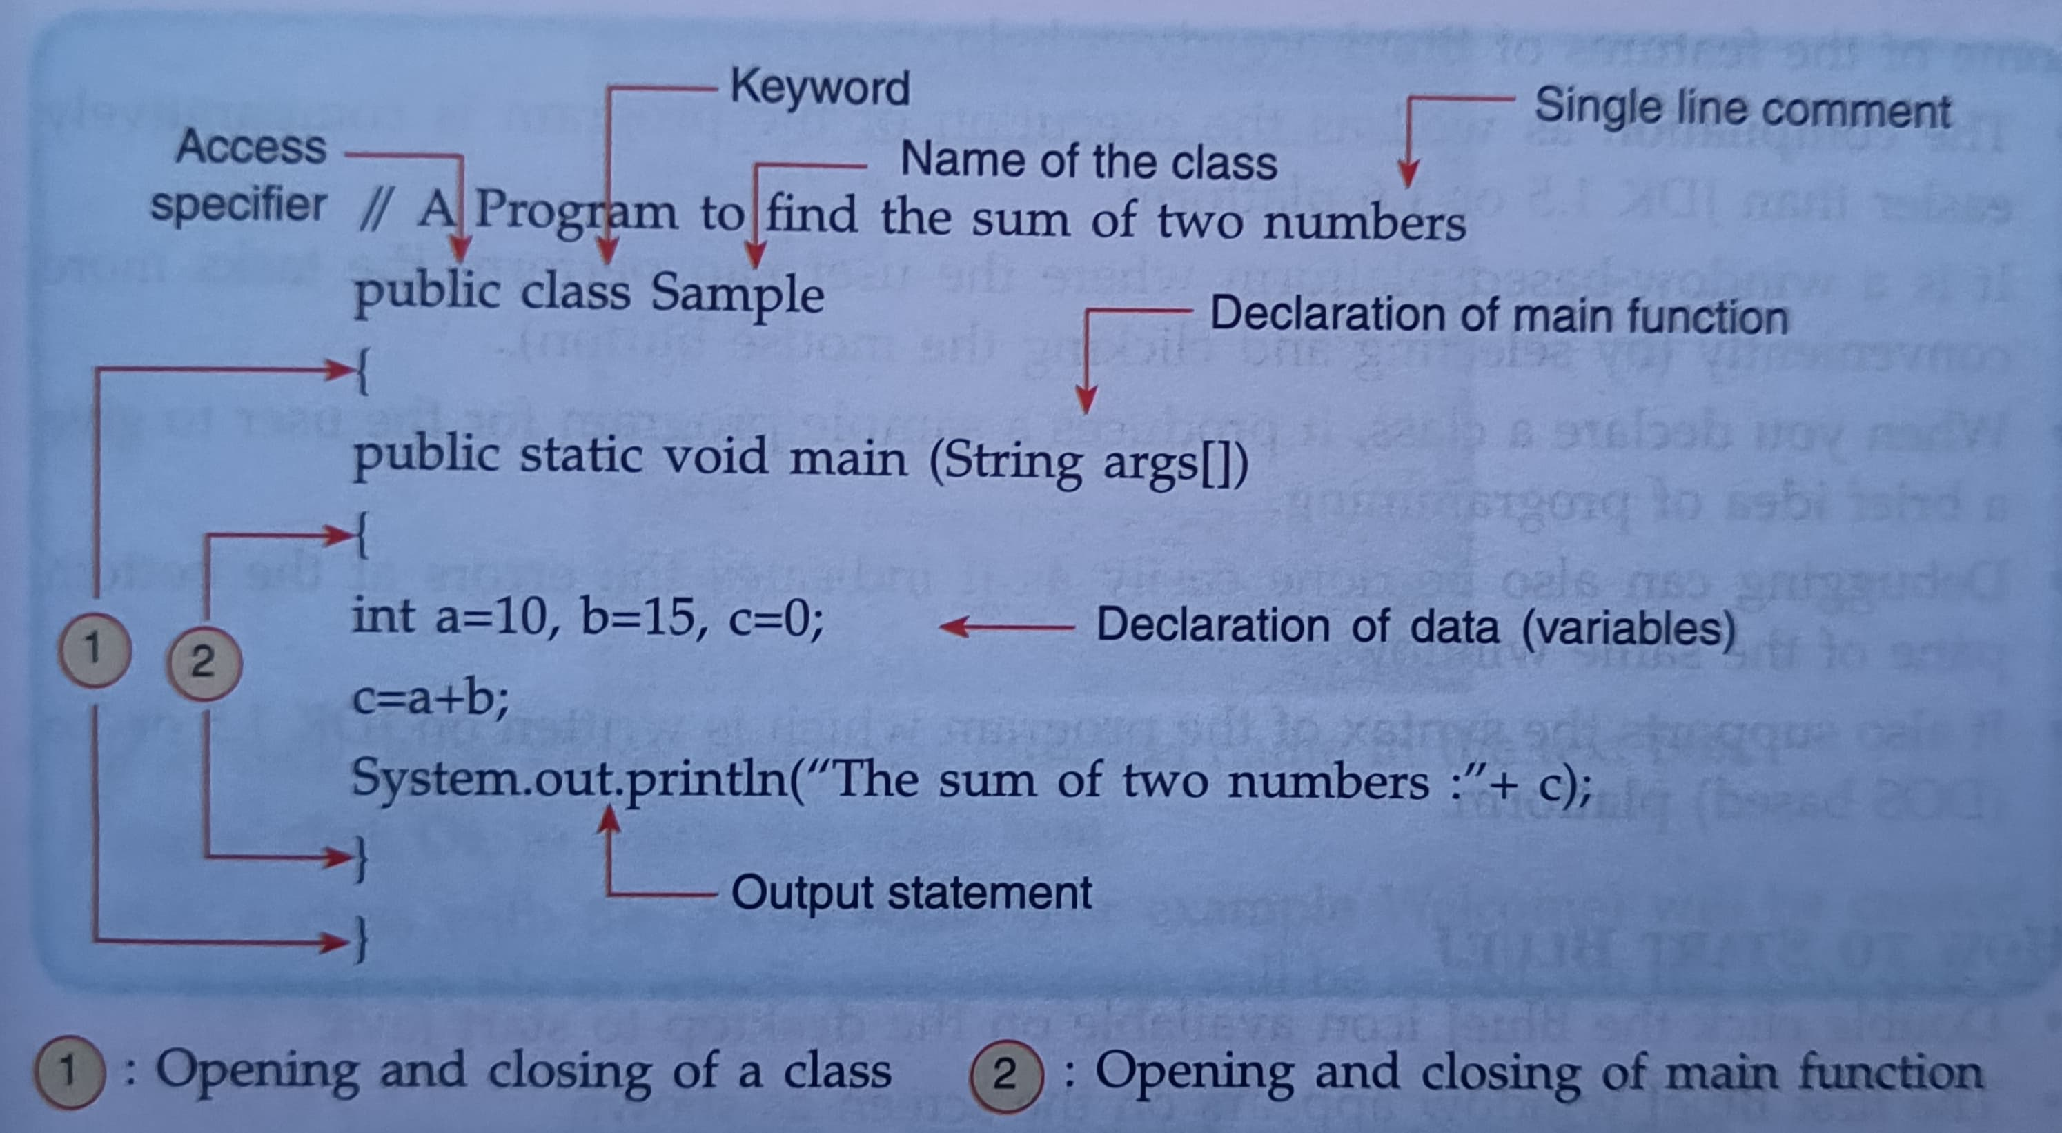
Structure of Java Programming
AN EXAMPLE IS ILLUSTRATED BELOW:

Slide 14
04.
Programming With Blue J
Features of blue j , Sample program.

Slide 15

Java Programming With Blue J
Blue J is an integrated development environment (IDE) for Java programming, specifically designed with educational purposes in mind. It was developed by Michael Kolling and John Rosenberg at Monash University in Australia. It is free of cost and JDK 1.5 or JDK 1.6 needs to installed on the system to use Blue J.

Slide 16
Features of Blue J:-
Some of the features of Blue J are:
The tasks can be performed more conveniently.
It shows you a sample program to give a brief idea of programming .
Debugging is easy as it indicates errors at bottom of screen.
It is a simpler interface than any other IDE.
It has some new features which are not seen in any other IDE.
Blue J can run on Windows, MacOS, Linux or any platforms which runs java.
It allows you to interact with objects.

Slide 17
Sample Program
It is a Sample program of add/Sum of two numbers:-
public class JavaExample
{
public static void main(String[]args)
{
// two integer variables with values
// and a variable "sum" to store the result
int num1 = 5, num2 = 15,sum;
//calculating the sum of num1 and num2 and
//storing the result in the variable sum
sum = num1+num2;
//printing the result
System.out.println("Sum of "+num1+" and "+num2+" is: "+sum);
}
}
OUTPUT:-
Sum of 5 and 15 is: 20

Slide 18
Sample Program
It is a Sample program of find the area of a triangle:-
import java.util.Scanner;
class Triangle
{
public static void main(String args[]){
Scanner scanner = new Scanner(System.in);
System.out.println("Enter the width of the Triangle:");
double base = scanner.nextDouble();
System.out.println("Enter the height of the Triangle:");
double height = scanner.nextDouble();
//Area = (width*height)/2
double area = (base* height)/2;
System.out.println("Area of Triangle is: " + area);
}
}
Enter the width of the Triangle:
2
Enter the height of the Triangle:
2
Area of Triangle is: 2.0

Slide 19
Team Details:-
RITAM HAZRA (CAPTAIN)
SUDIPTA CHATTERJEE(VICE-CAPTAIN)
AAYAN GUHA(MEMBER)
POTHOMADITYA SHIL(MEMBER)

Slide 20
Thanks!
Do you have any questions?
Ask us for Solutions.
Be Free from all of your doubts.
A GREAT THANKS TO ALL OF YOU FOR ATTENDING AND LISTENING US.

Slide 21

Template credit goes to -

